Slide 1

Hair Salon

Slide 2
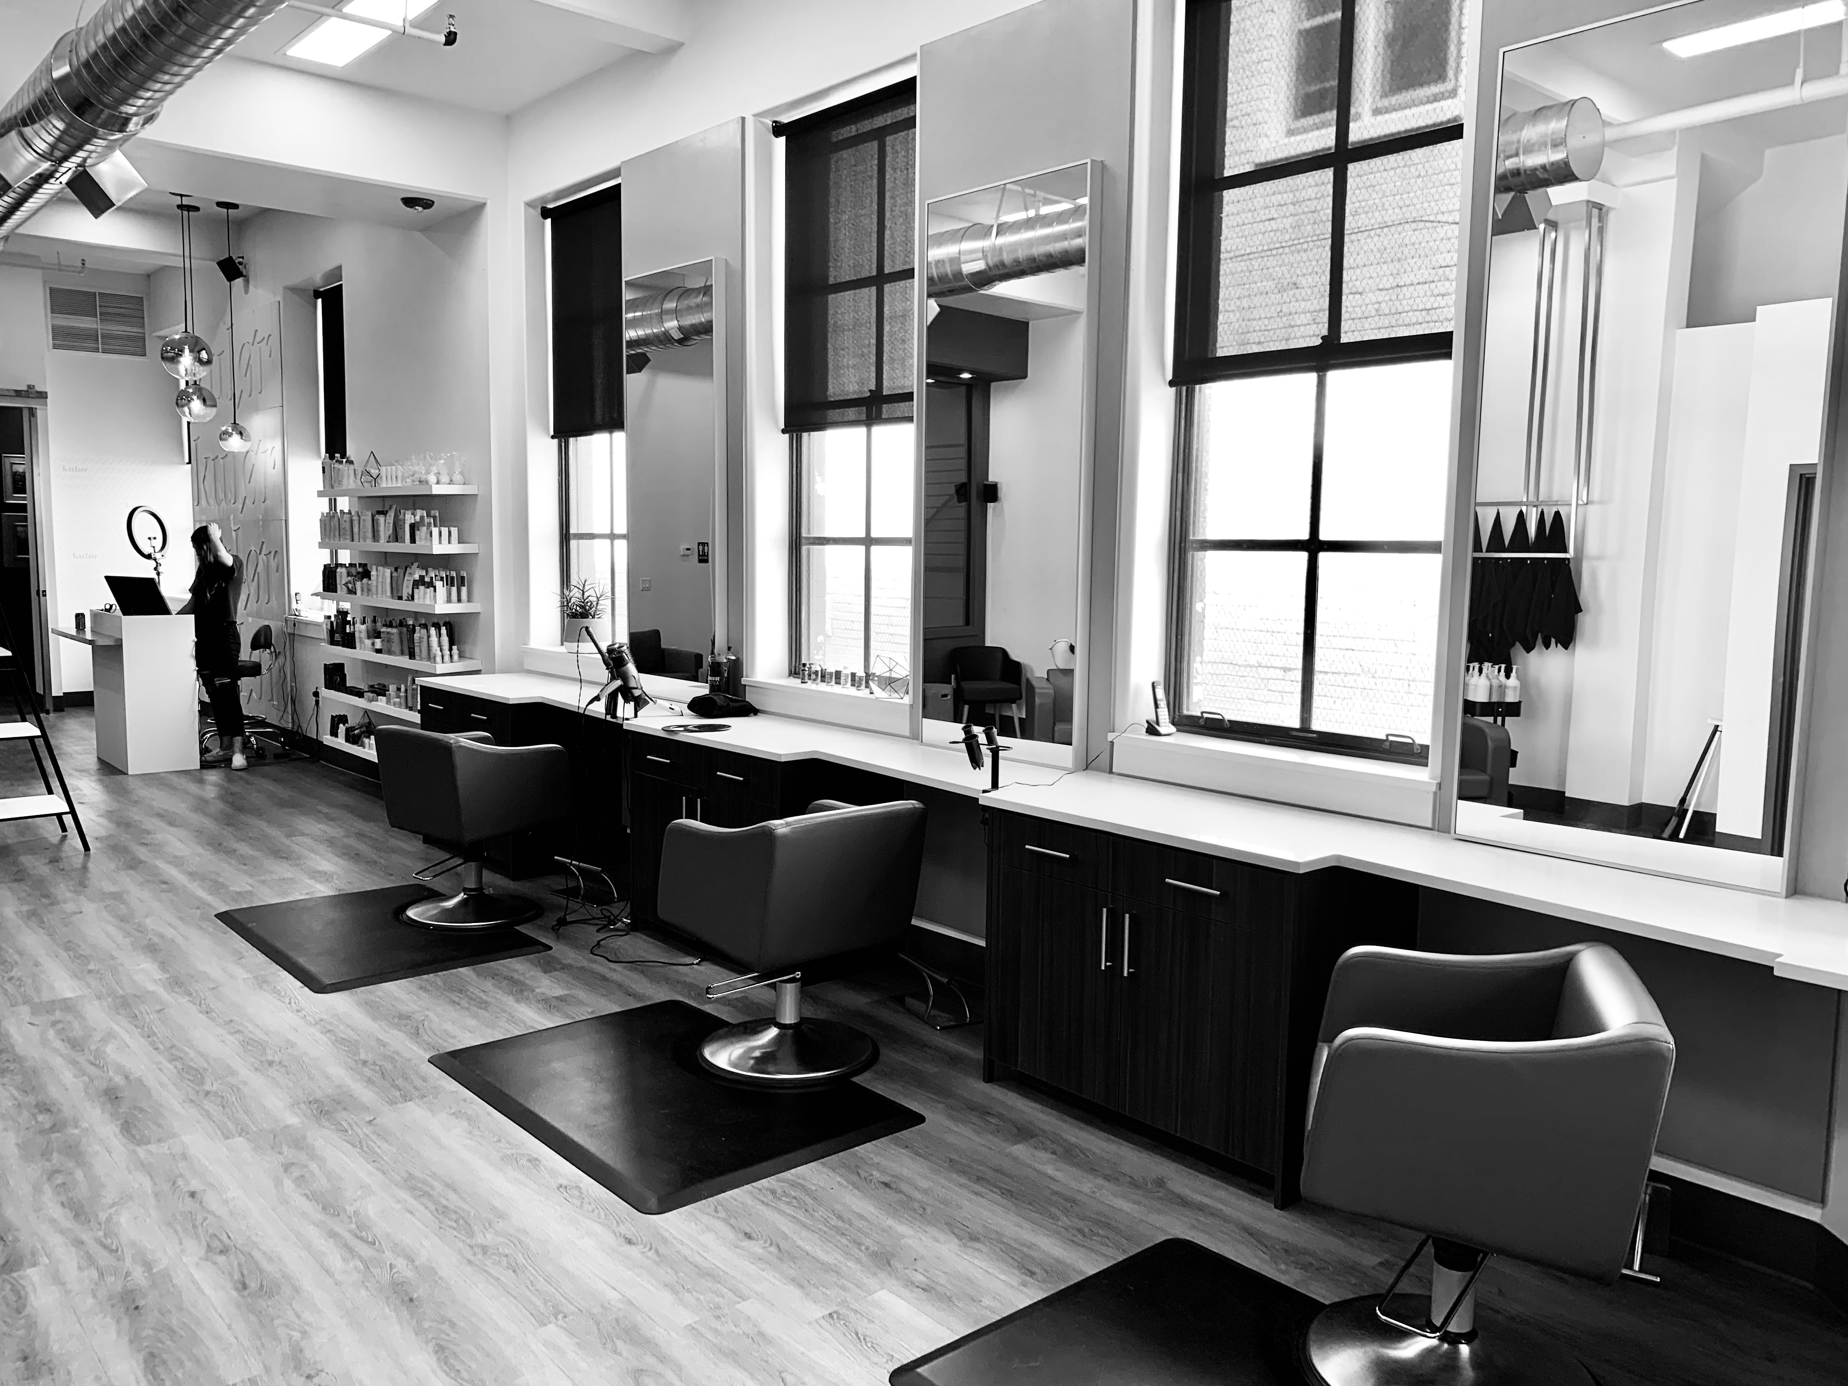
Agenda
Data source
ER Diagram
Data Modifications
Business Needs
Insights

Slide 3
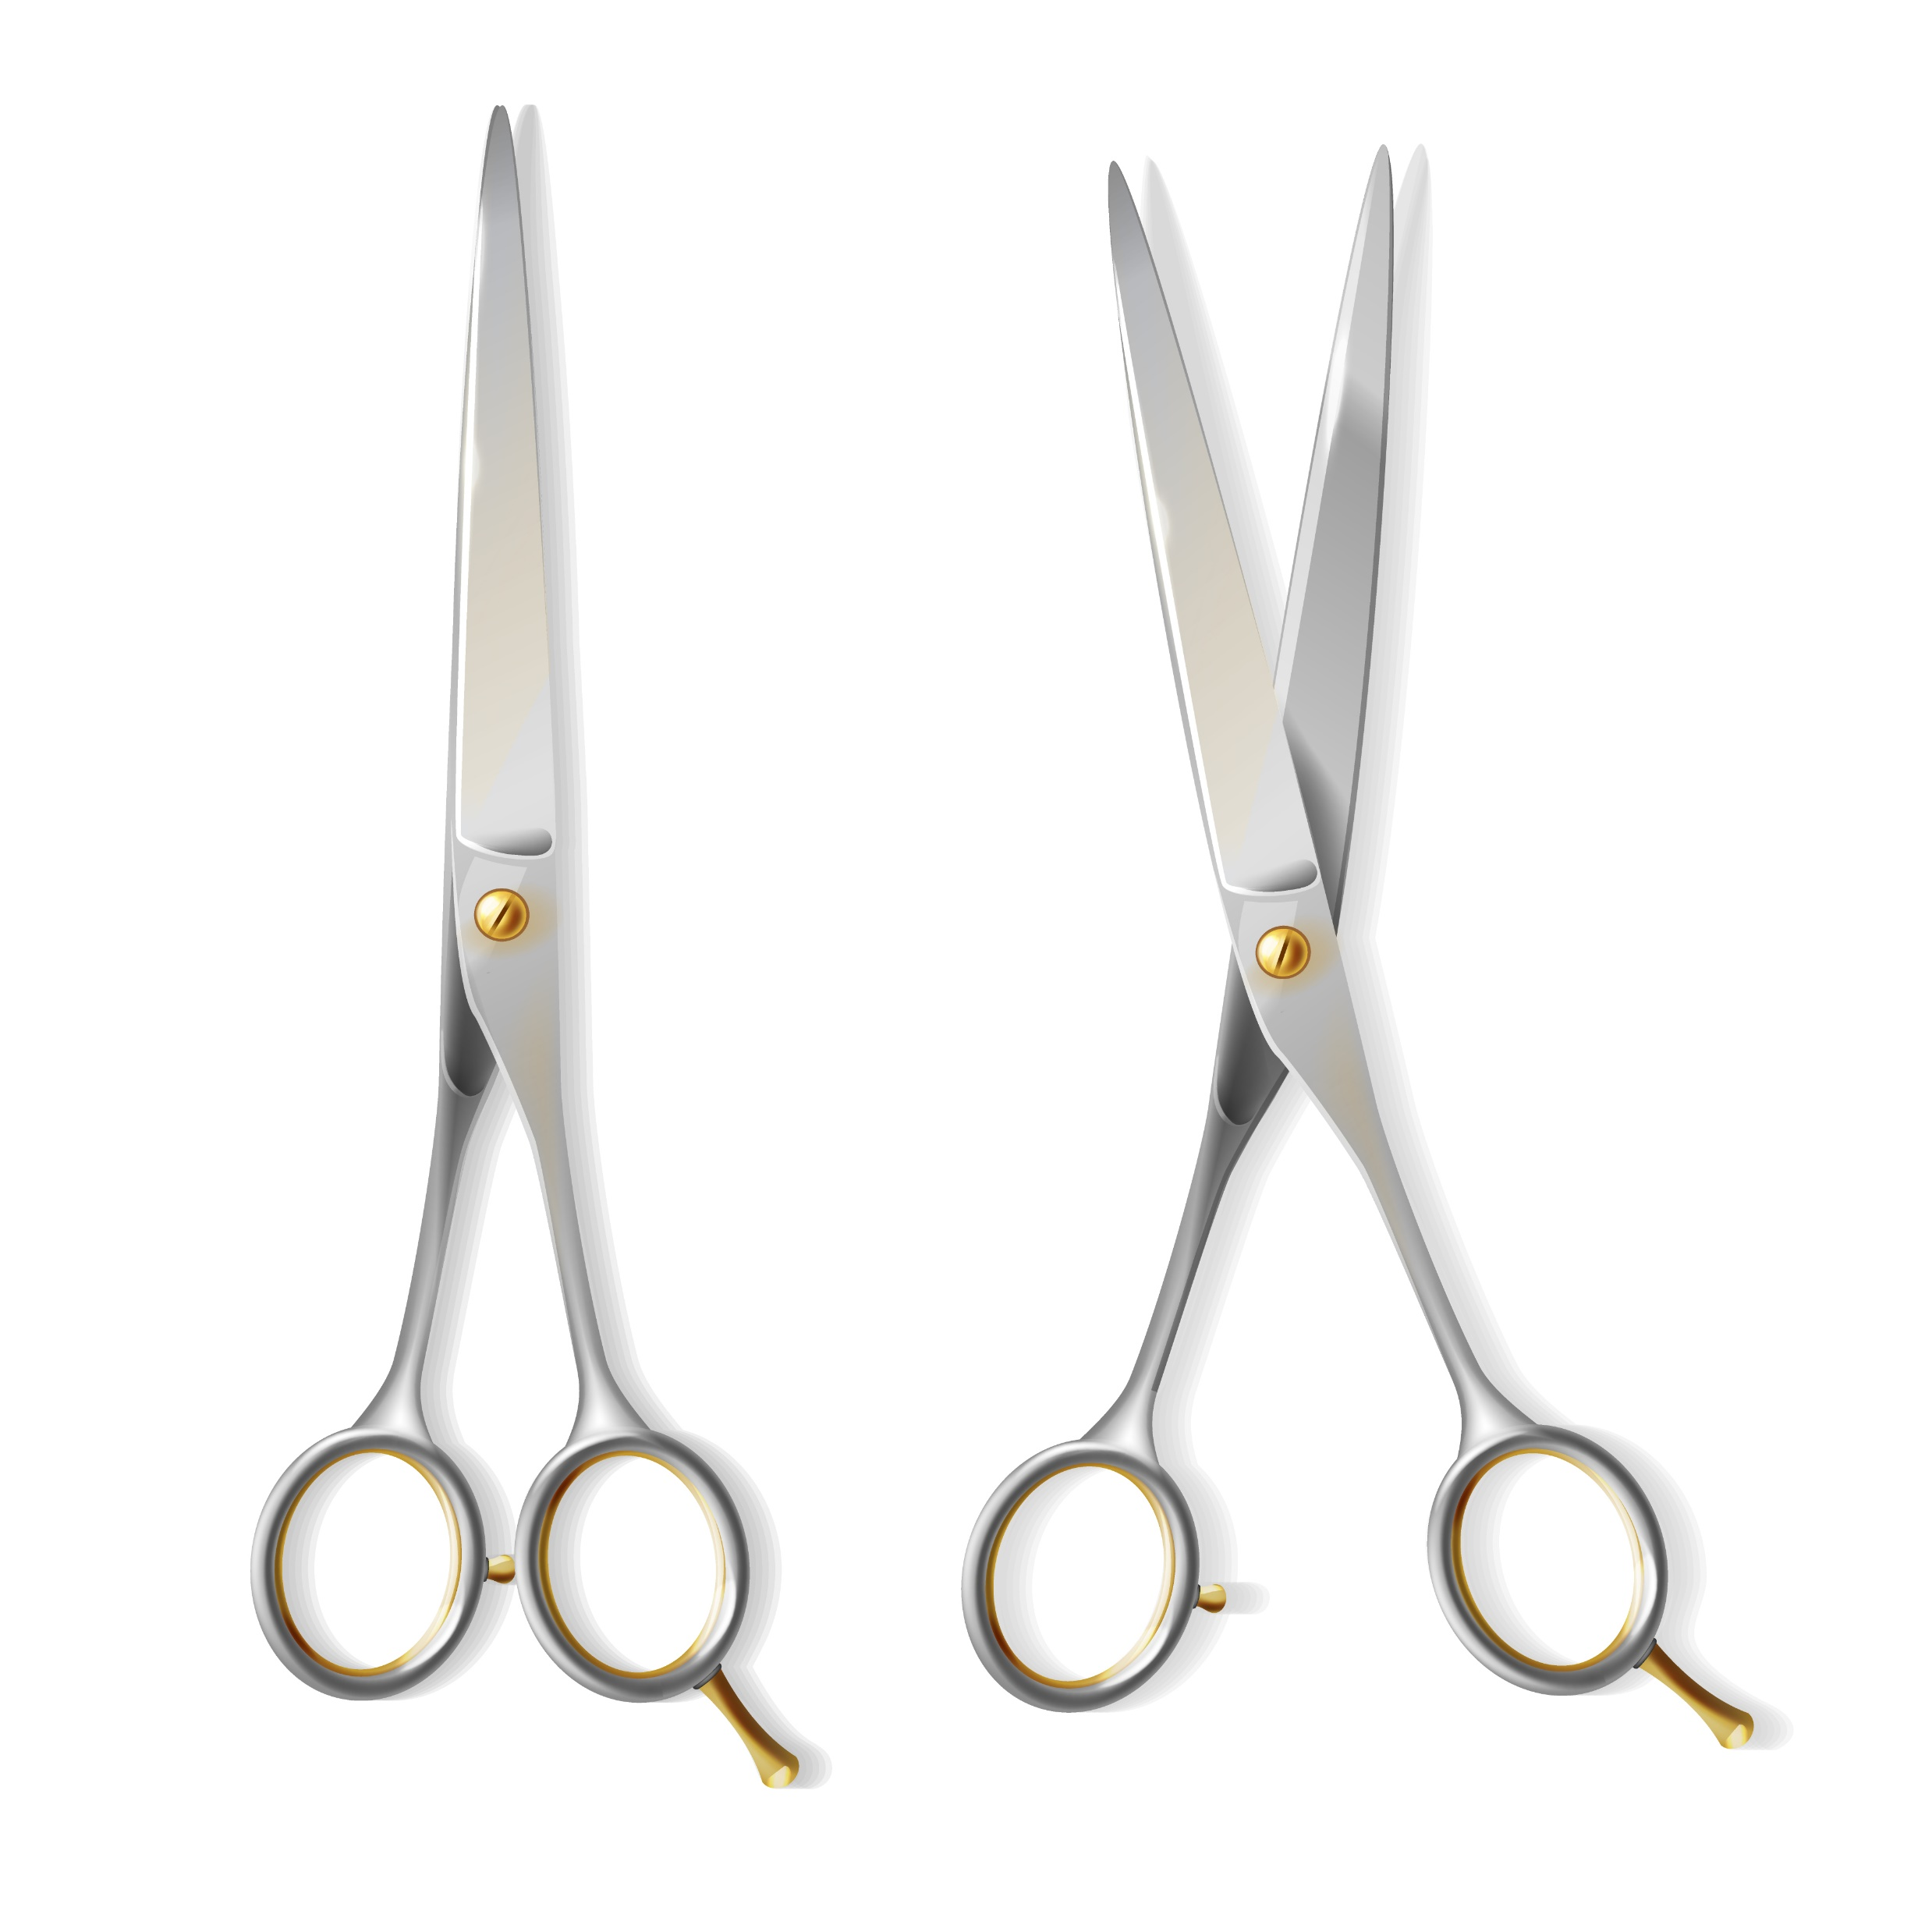
Data Source
Kaggle
The data was based on an actual hair salon in Toronto, Canada
The data consists primarily of attributes of the appointment booking and excludes client or staff member details
Bookings table time series between 2018-03-14 to 2019-02-15
Transactions table time series between 2018-03-15 to 2018-07-29

Slide 4
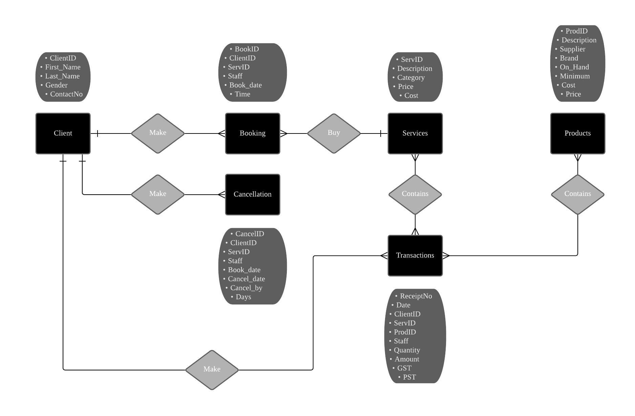

Slide 5

Data Modifications

Slide 6
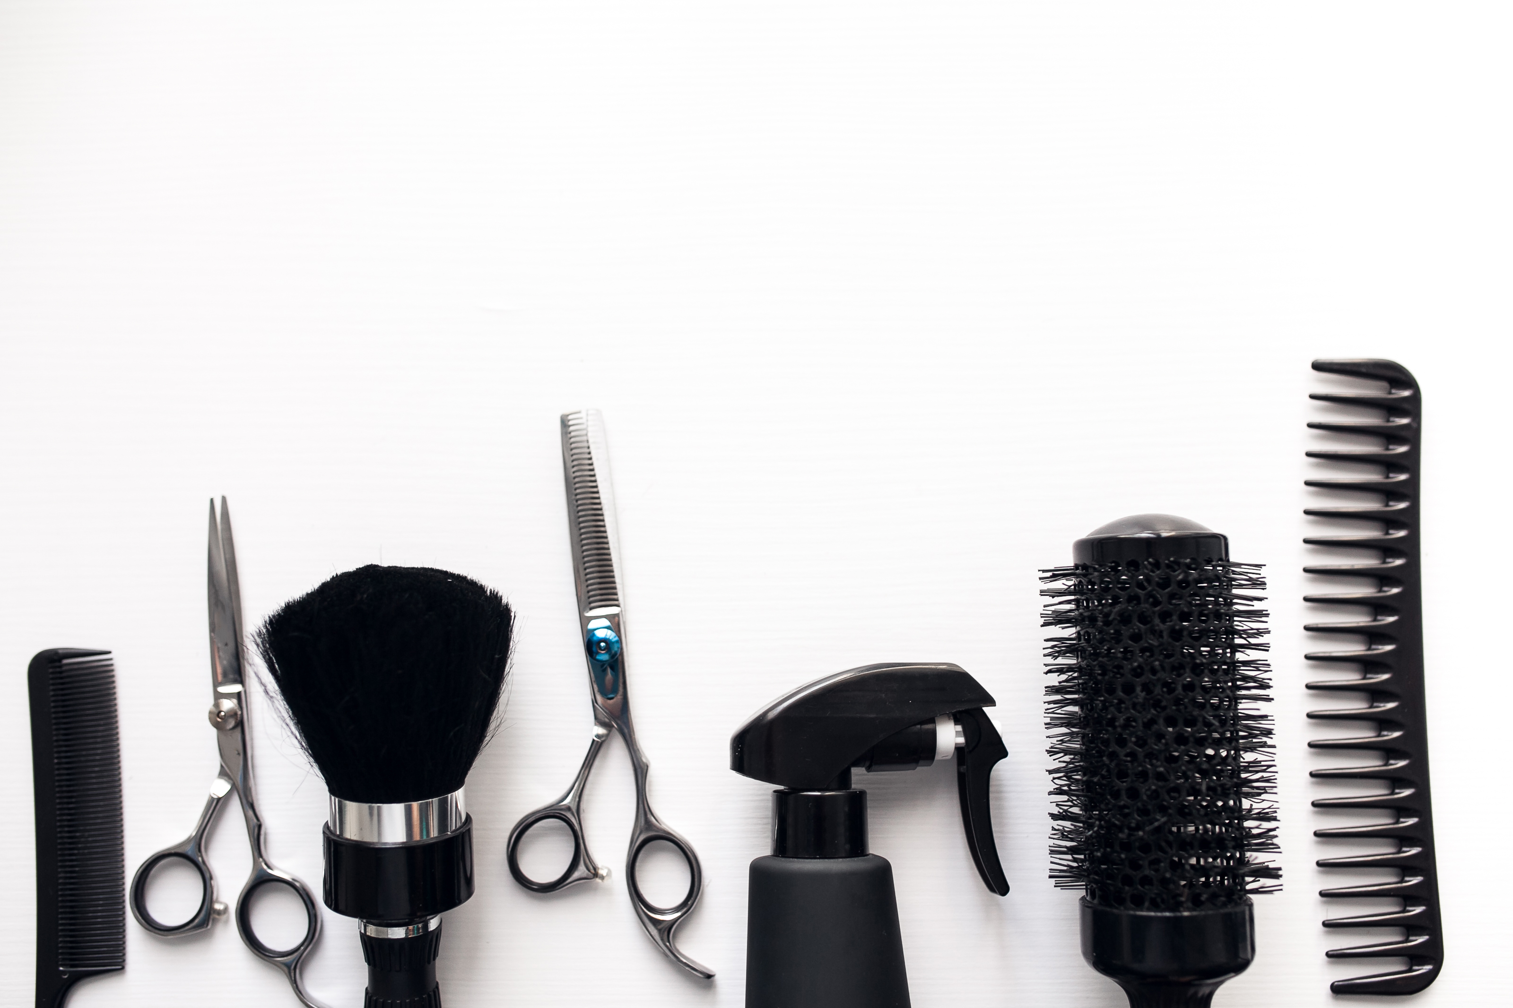
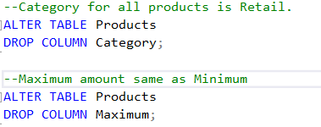
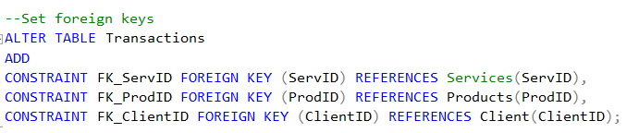
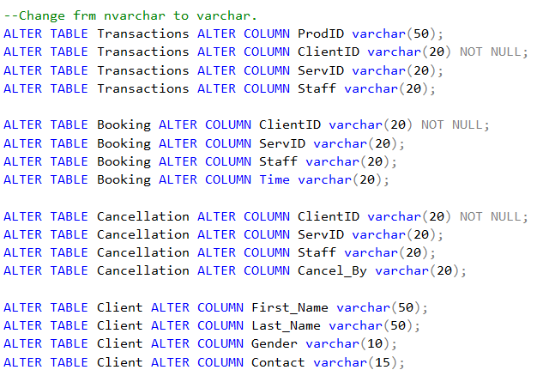
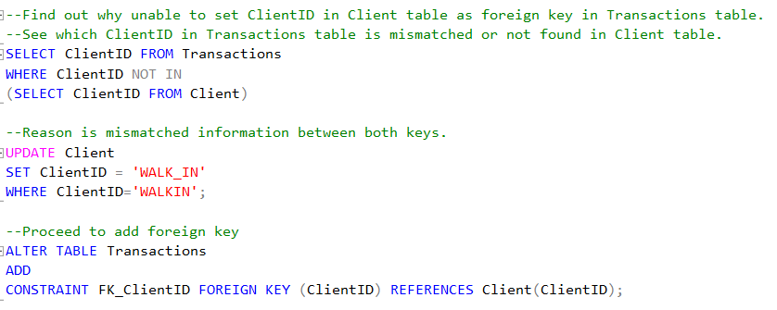
1
3
2
4

Slide 7
5. Create Client Table
Columns:
ClientID (based on Booking and Cancellation tables)
Gender (VLOOKUP the services in Booking and Cancellation table)
First_Name [IF(D2="F",INDEX(Sheet1!$A:$A,RANDBETWEEN(1,COUNTA(Sheet1!$A:$A)),1),INDEX(Sheet1!$D:$D,RANDBETWEEN(1,COUNTA(Sheet1!$D:$D)),1))]
Last_Name [INDEX($A:$A,RANDBETWEEN(1,COUNTA($A:$A)),1)]
Contact [RAND()*(9999999999-1000000000)+1000000000]

Slide 8

Business Needs
What are the top 10 popular products?
What are the top and bottom 10 services?
Which is the busiest day?
Who is the top client who spend more than $600 and has more than 10 bookings and transactions?
Which staff has the best performance in sales?
Is the no show rate high?

Slide 9
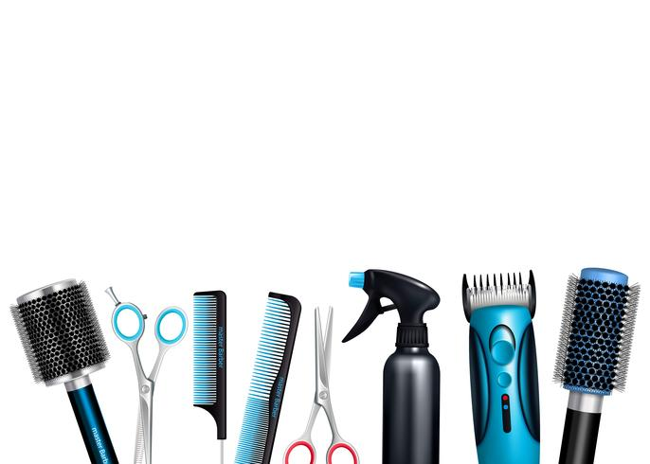
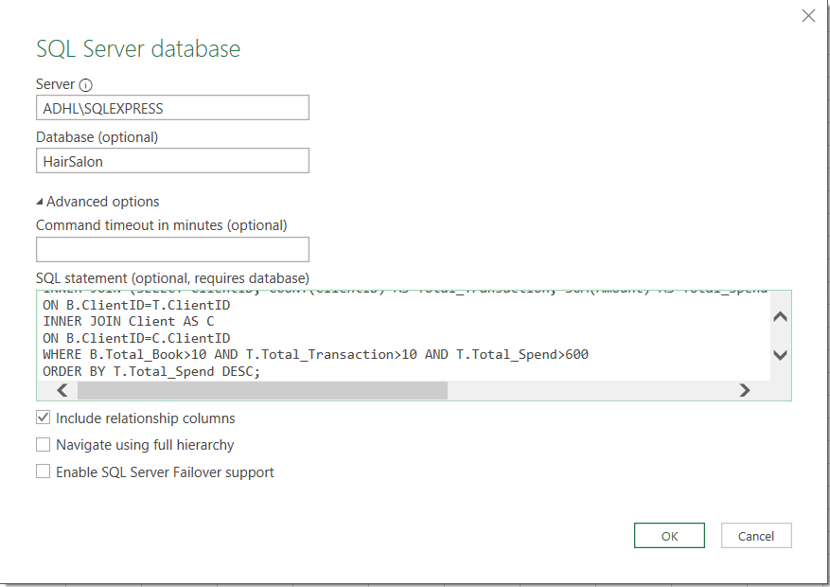
Load SQL syntax into Excel

Slide 10



Insights

Slide 11

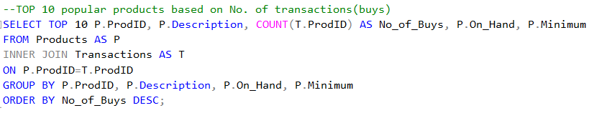
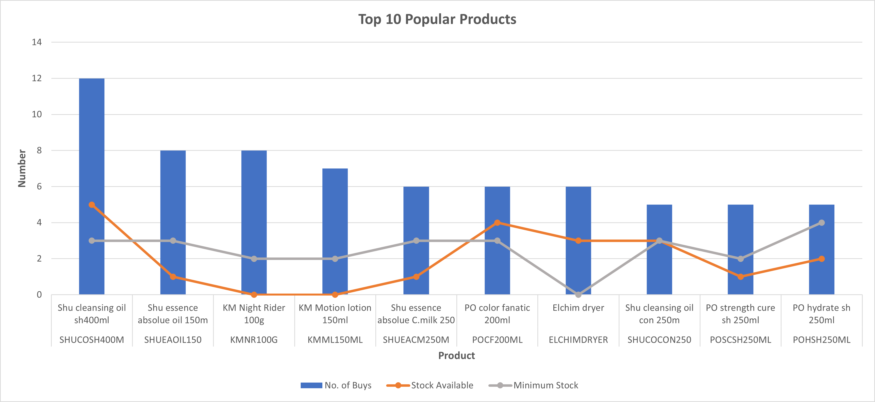
Top 10 Products

Slide 12
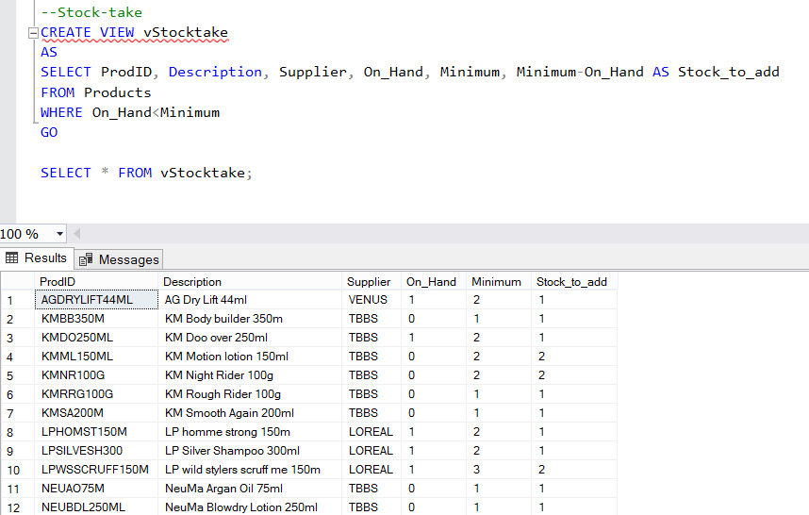
Products Stock-take View

Slide 13
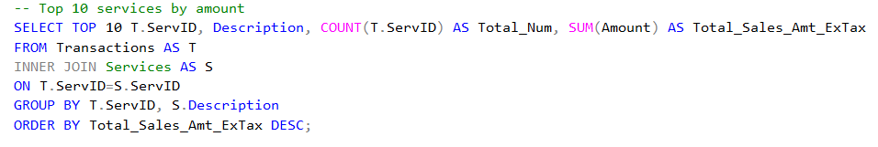
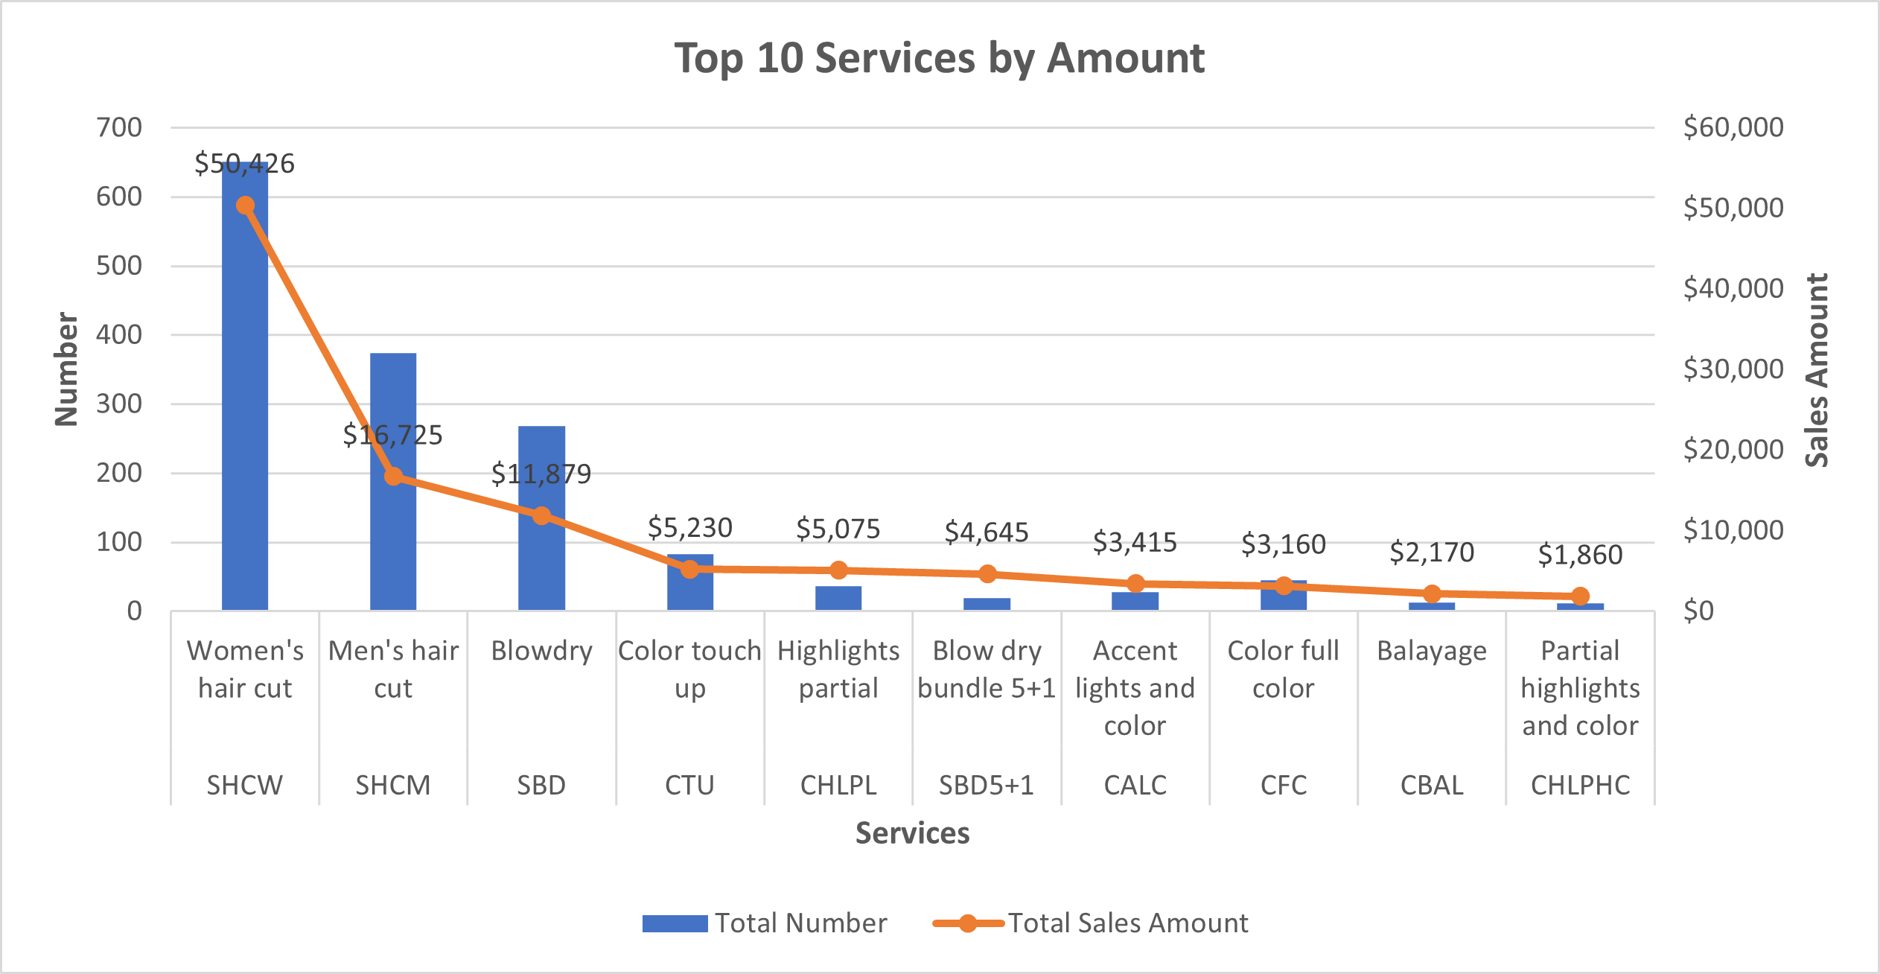
Top 10 Services

Slide 14
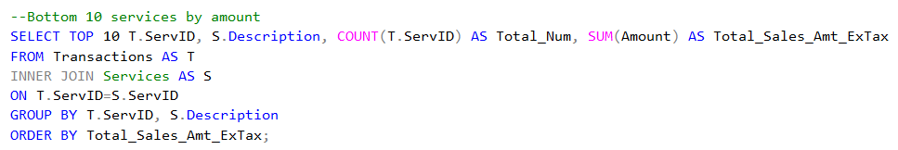
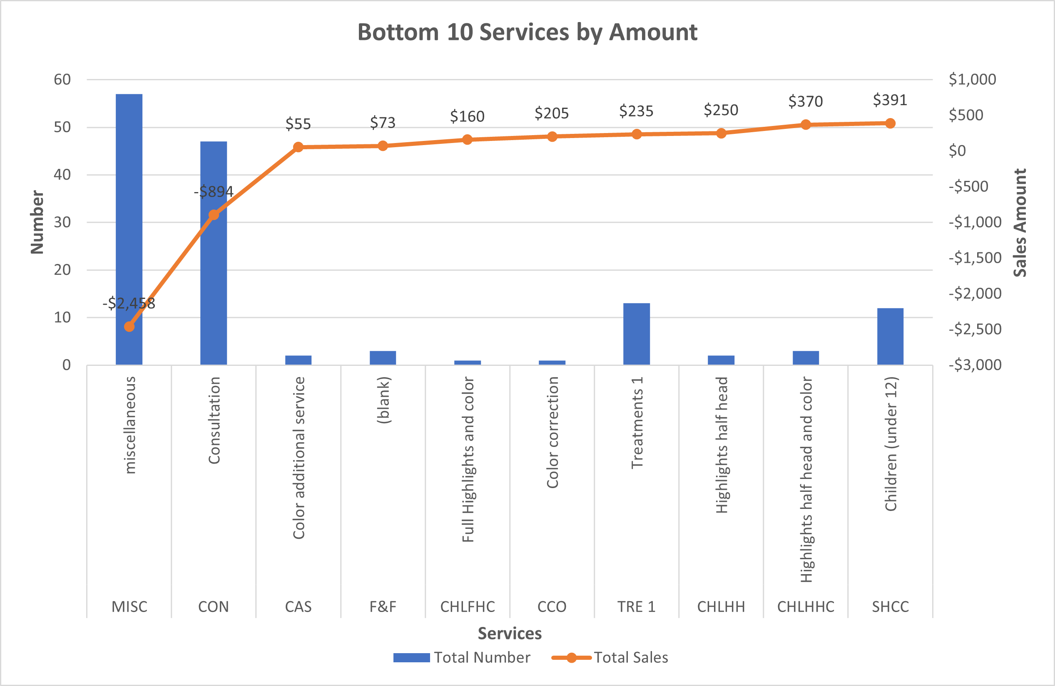
Bottom 10 Services

Slide 15
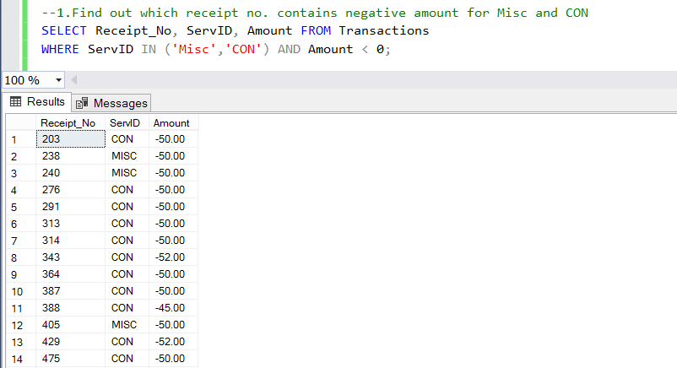
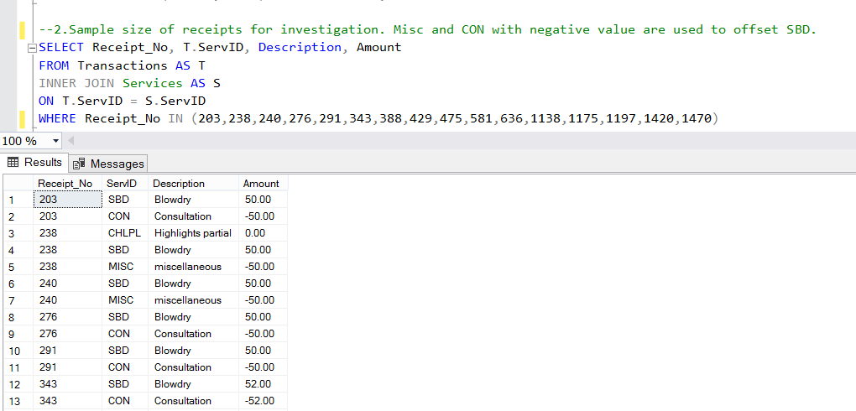
Bottom 10 Services (Check)

Slide 16
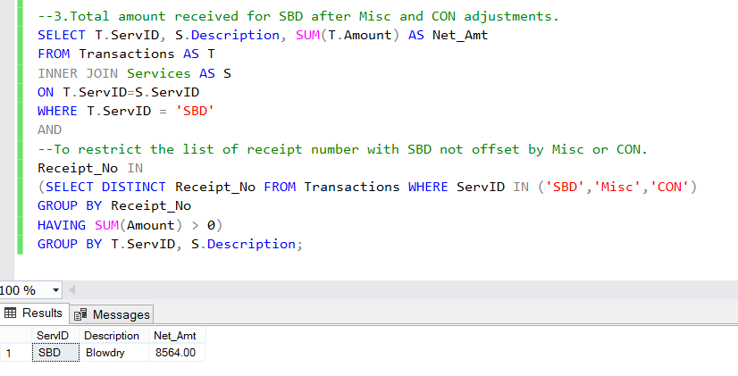
Bottom 10 Services (Check)
Is Blowdry still Top 3 Services?

Slide 17

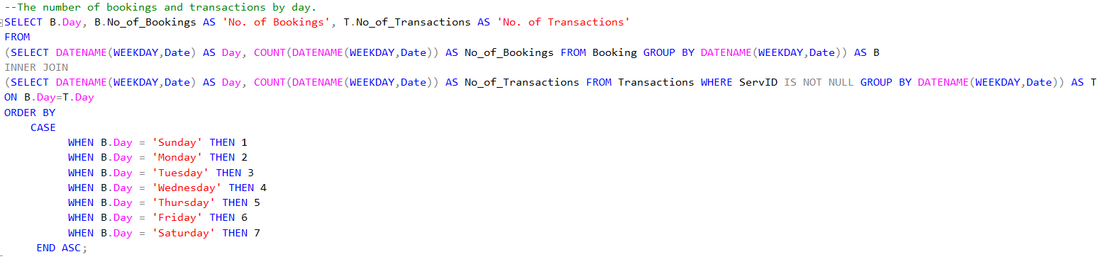
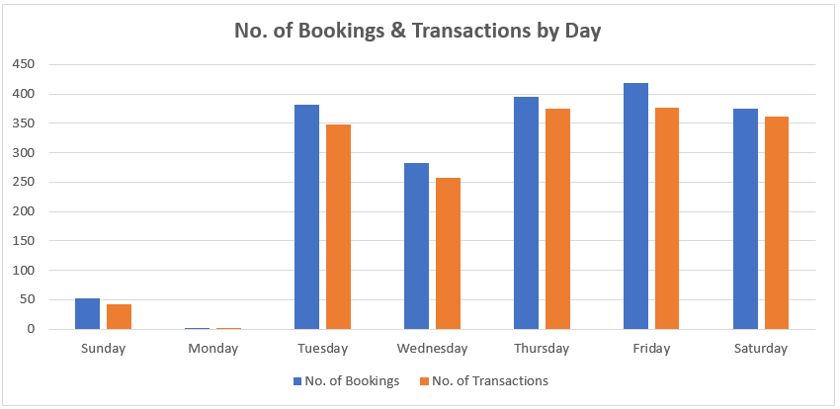
Busiest Day

Slide 18
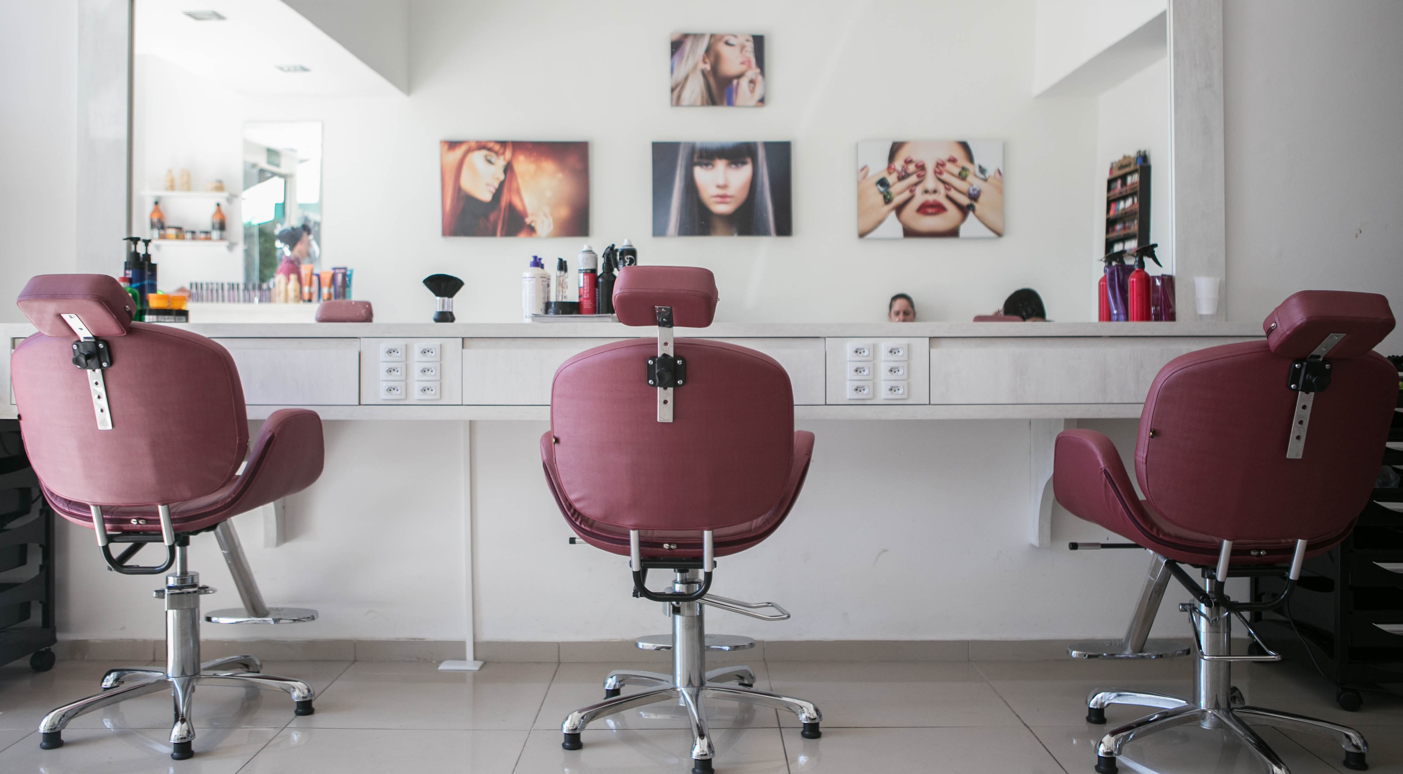
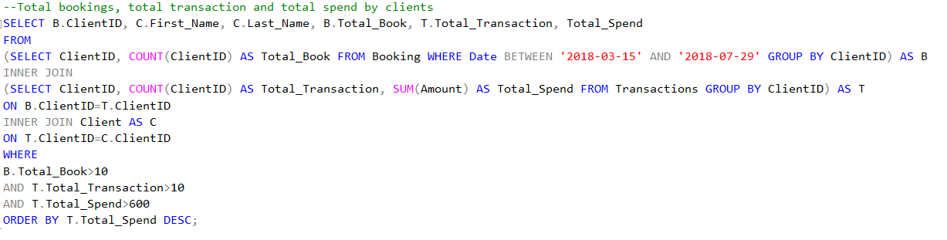
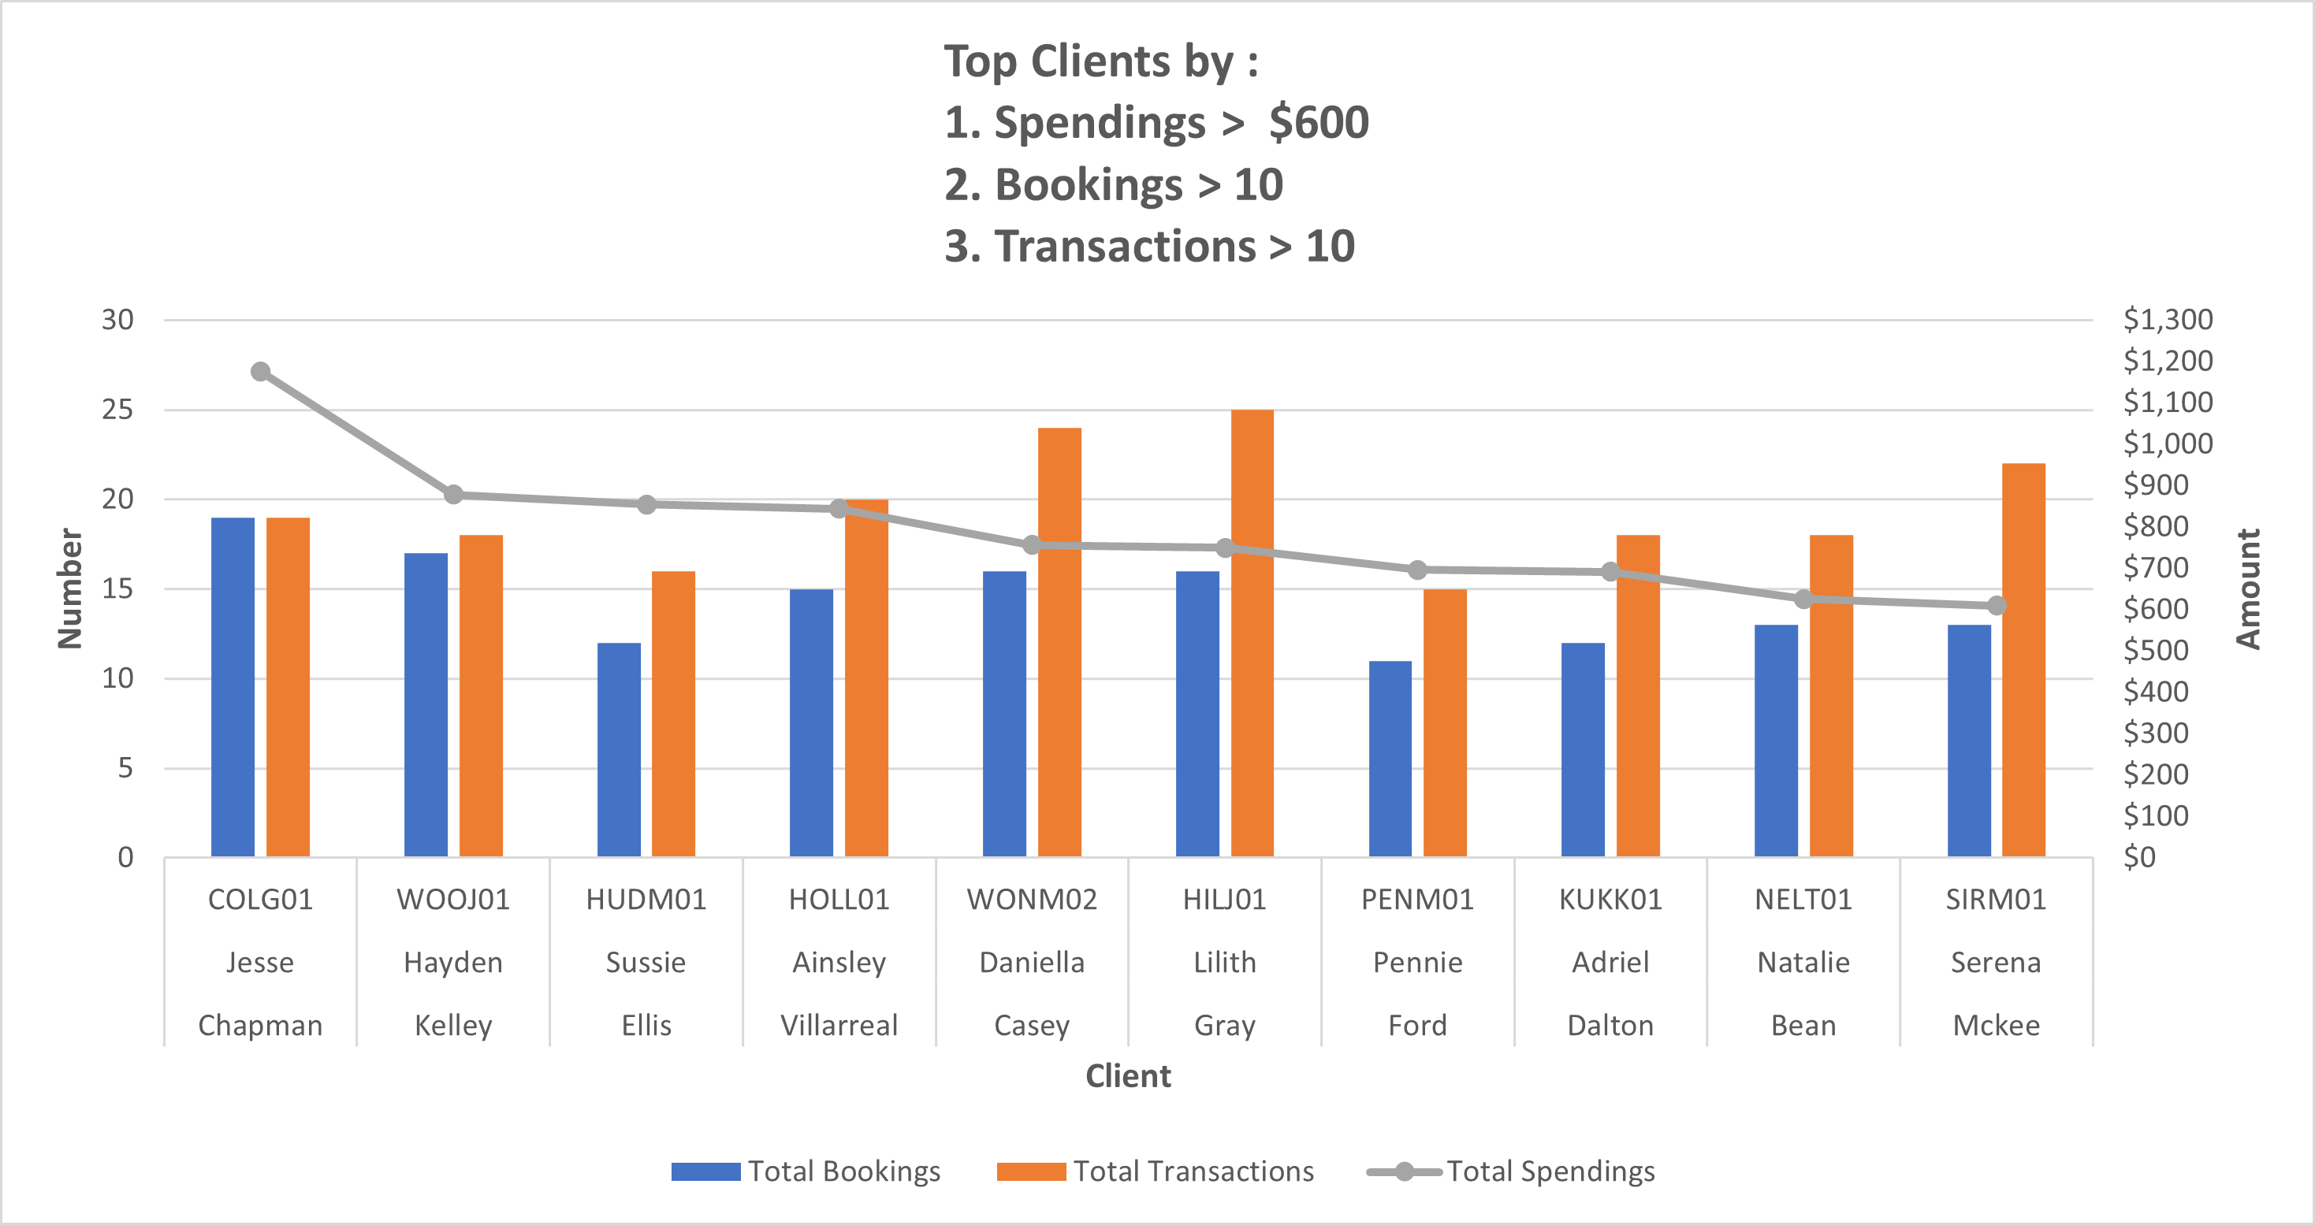
Top Clients
Jesse Chapman

Slide 19

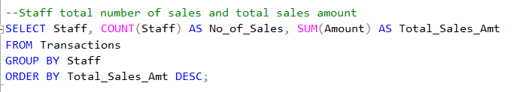
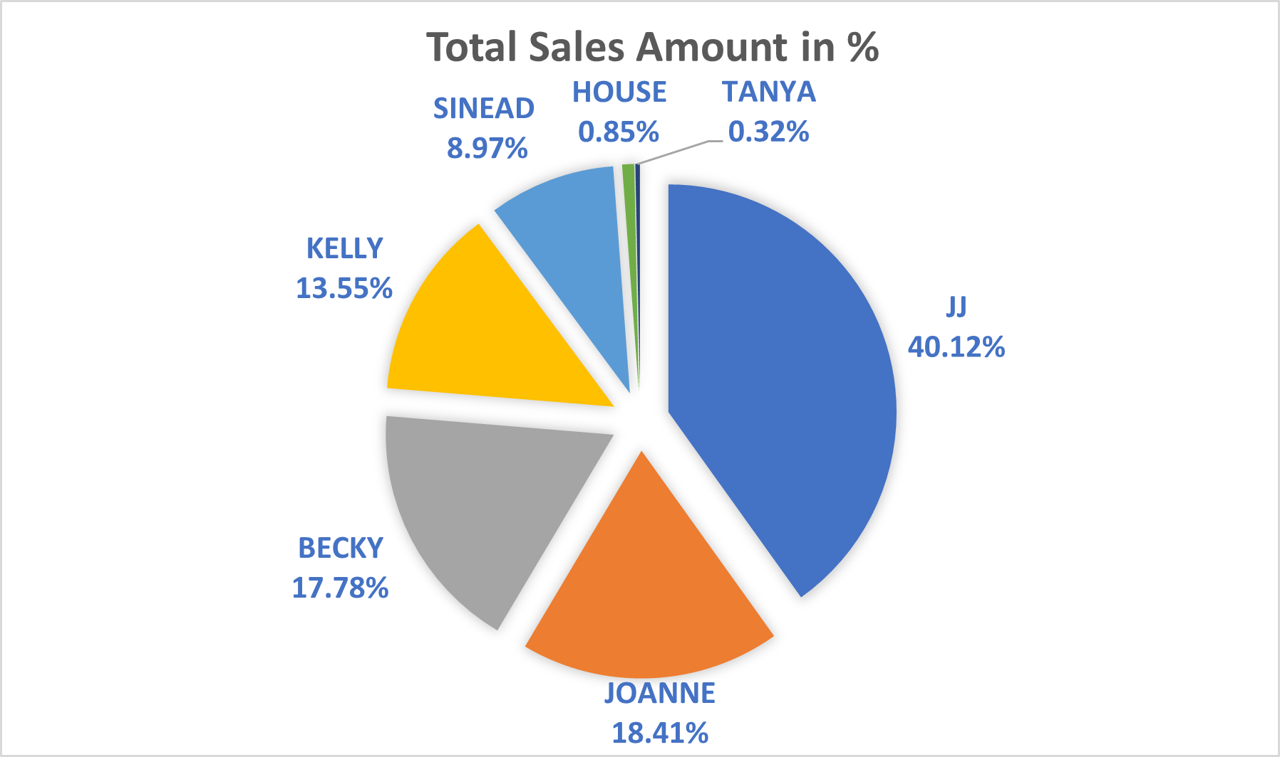
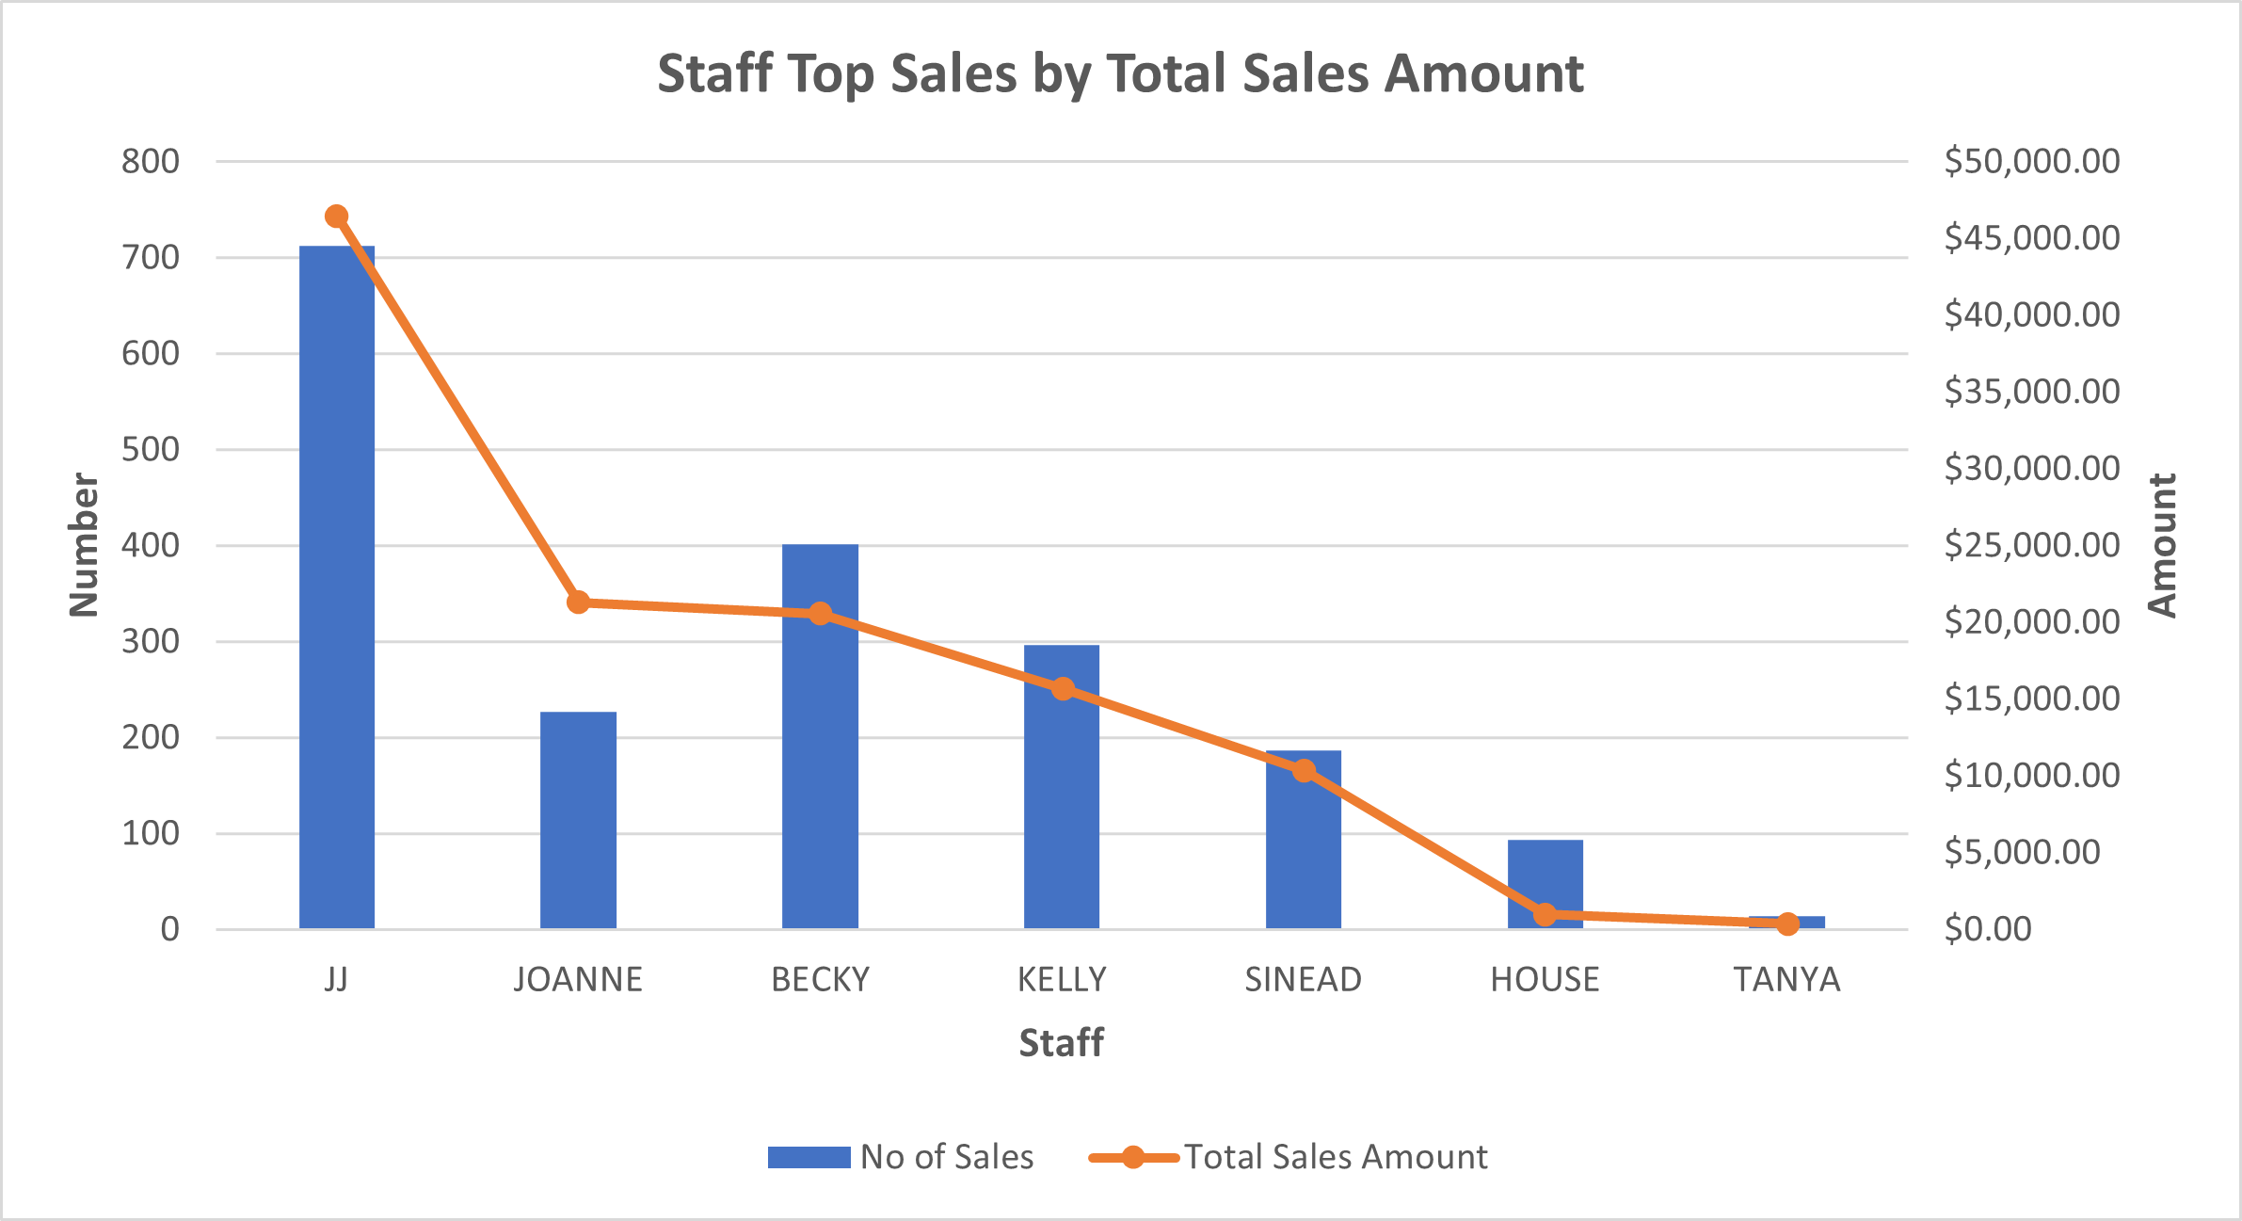
Staff Top Sales

Slide 20
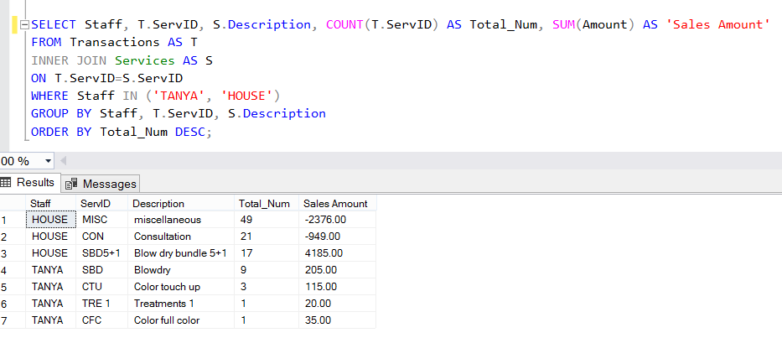
Staff Top Sales
(Check)

Slide 21
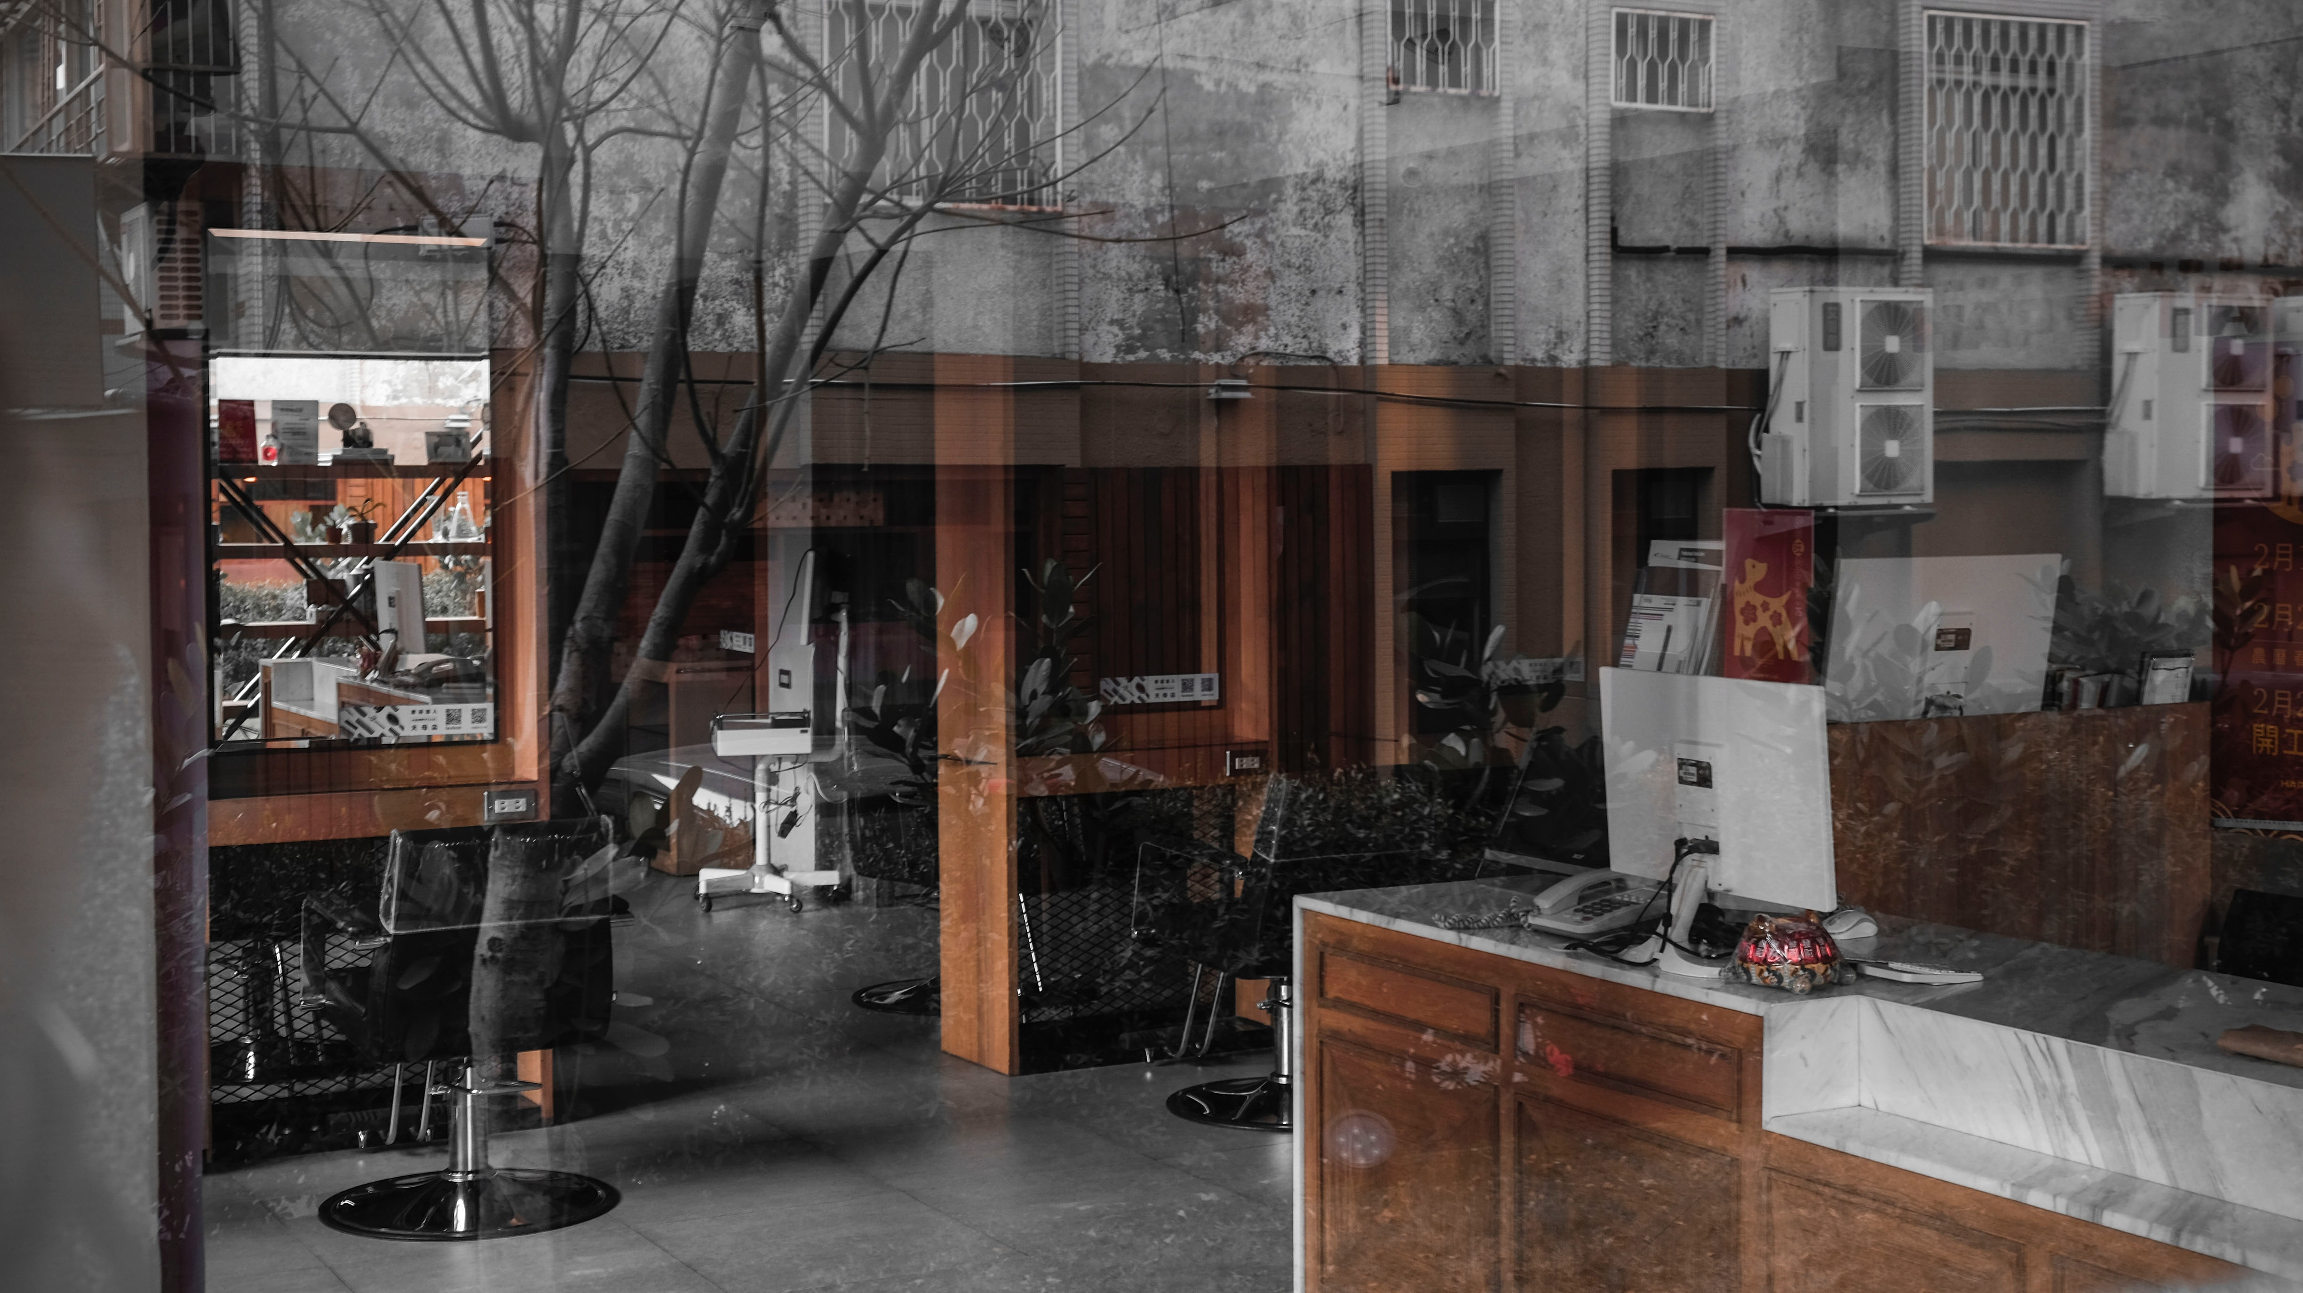
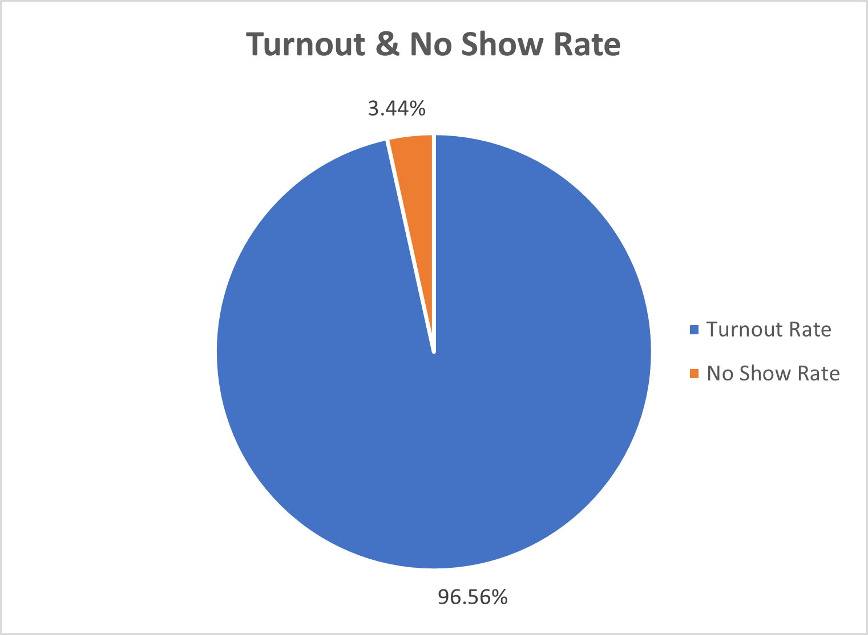
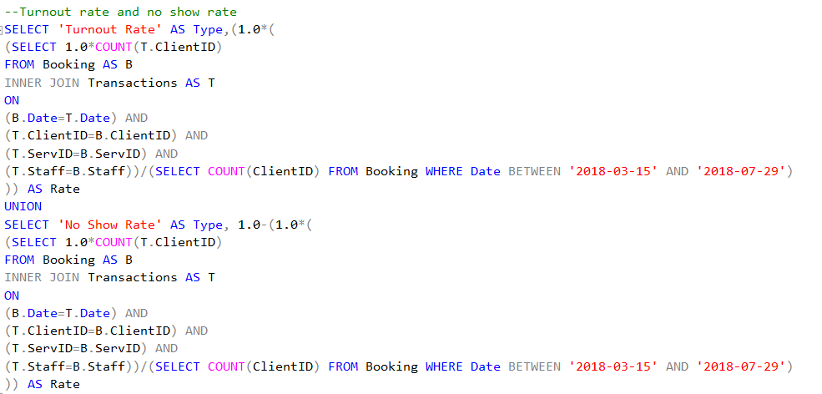
No Show Rate

Slide 22

Add-ons

Slide 23
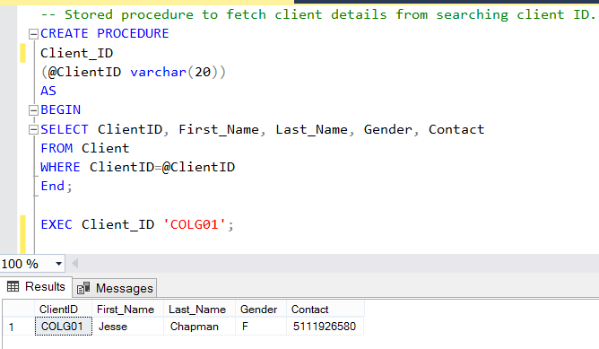
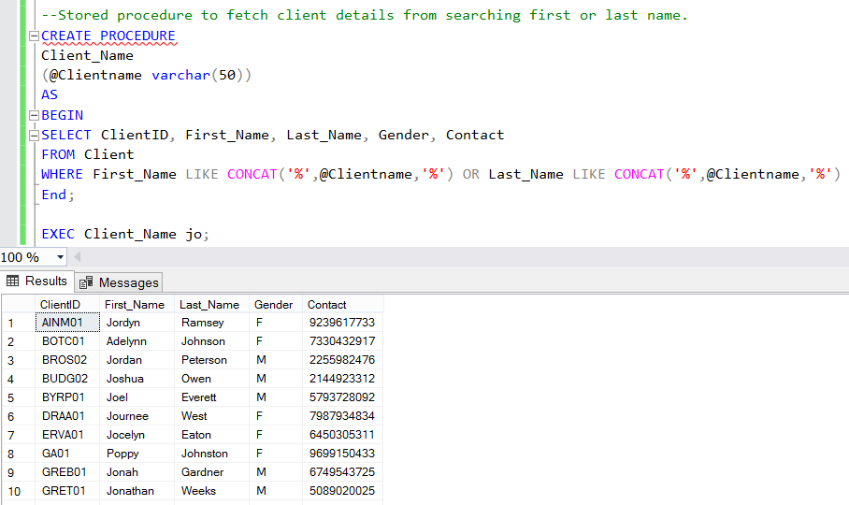
Stored Procedures

Slide 24
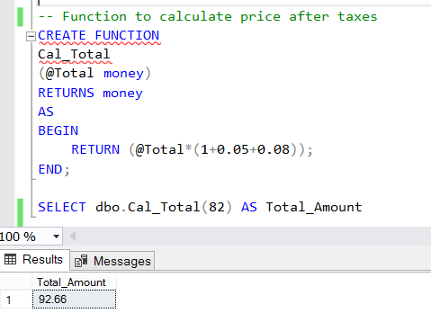
Function

Slide 25

Questions?

Slide 26
References
Kaggle, https://www.kaggle.com/frederickferguson/hair-salon-no-show-data-set?select=Product+Listing+%28Retail%290.csv
Data.gov, https://catalog.data.gov/dataset/baby-names-from-social-security-card-applications-national-level-data
Namecensus, https://namecensus.com/data/1000.html

